Slide 1


Pharmacy Analytics
Analytics Lakehouse
Data-Driven Inventory Insights
PRESENTED BY
Guru Saran Satsangi Peddinti

Slide 2

Problem Statement
Retail pharmacies are confronted with significant analytics challenges that lead to frequent stock-outs of essential medicines, resulting in lost sales and dissatisfied customers due to poor inventory management.

Slide 3

Solution Overview
This section outlines the development of a Pharmacy Analytics Lakehouse utilizing the Databricks platform, emphasizing data-driven insights for inventory management and sales intelligence while ensuring privacy compliance.

Slide 4

Architecture & Data Flow
This section outlines the data ingestion process into the Bronze layer, emphasizing the importance of capturing source fidelity for accurate analytics and decision-making in pharmacy operations.

Slide 5
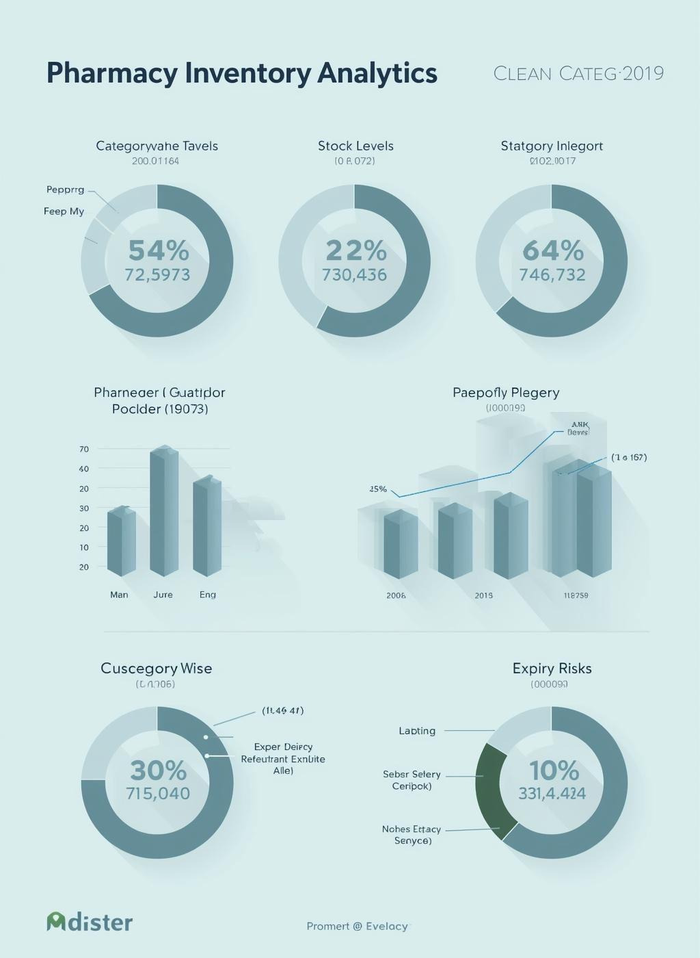
Analytics & Dashboards
Our dashboards offer comprehensive inventory visibility, enabling pharmacies to manage stock level effectively and make informed decisions based on real-time data insights.

Slide 6

Machine Learning Models
This section explores the development of regression models to quantitatively predict stock risk scores, enhancing inventory management through data-driven insights and proactive decision-making strategies.

Slide 7

Project Impact
This project has enabled significant reductions in expiry-related inventory losses while improving operational efficiency and medicine availability through innovative data-driven strategies and analytics.

